Slide 1
Windows 10 Module 5
Using Apps to Manage Media

Slide 2
Module Objectives
Get information with media apps
Take photos and videos with the camera
View and edit photos
Get and play music or videos
View and play games
Use Windows Media Player
Word with media in File Explorer
View and read documents

Slide 3
Get Information with Media Apps
Windows 10 comes with media-related apps
Get specialized information
Capture photos and video
Watch movies and TV shows
Listen to music
Play games
MSN supplies specialized apps such as Money, Maps, News, Sports, and Weather
Access media apps from the Start menu

Slide 4
Take Photos and Videos with the Camera (Slide 1 of 2)
Camera app allows you to take photos and video
Must have a digital camera or a webcam installed on your device
Preview and edit your photos and video using the Photos app
Pictures automatically saved in the Camera Roll folder in This PC > Pictures folder
Can change camera options

Slide 5
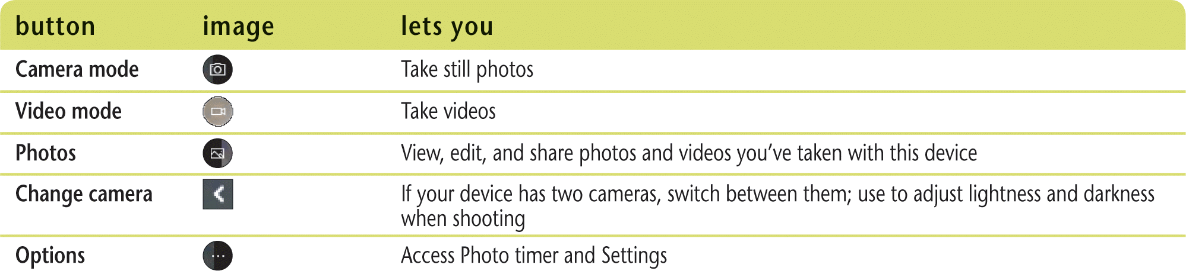
Take Photos and Videos with the Camera (Slide 2 of 2)
Camera and image control buttons

Slide 6
View and Edit Photos (Slide 1 of 2)
Photos app provides storage for photos, pictures, and videos
Pictures folder is stored locally on your device
Use Photos app to view photos and videos
Pictures folder
OneDrive
Attached devices
Online sites such as Facebook and Flickr
Can trim videos

Slide 7
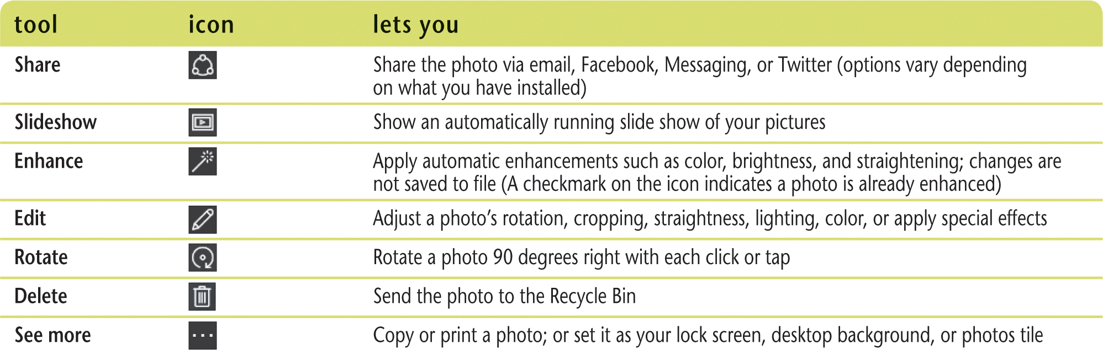
View and Edit Photos (Slide 2 of 2)
Photos app tools

Slide 8
Get and Play Music or Videos (Slide 1 of 2)
Groove Music app allows you to get music from the Internet and play it on Windows 10 devices
Create and edit playlists
Need a monthly subscription to Groove to download music
Groove Music Pass
Streaming music is music you can listen to as it is being downloaded from the web
Movies & TV app allows you to manage and play videos and TV shows
From own collection
Purchased through Microsoft store

Slide 9
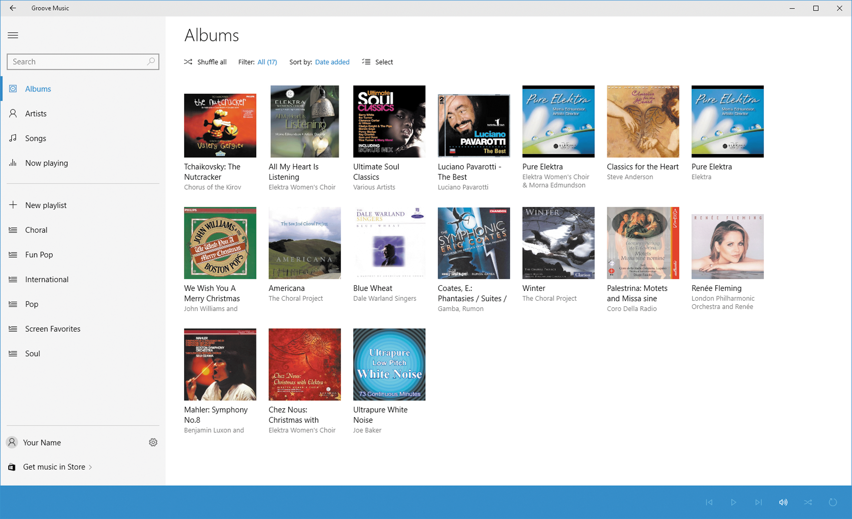
Get and Play Music or Videos (Slide 2 of 2)
Groove Music app

Slide 10
View and Play Games
Play local or online games using the Xbox app
Purchase games from Windows Store
Game players
Have a user profile that includes a gamertag
Can create and customize an avatar
Xbox One gaming system
console and wireless handheld controller
Purchase games from Xbox Live

Slide 11
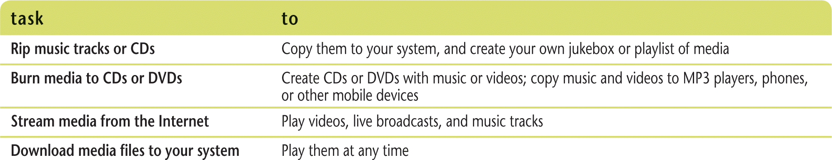
Use Windows Media Player (Slide 1 of 2)
Use Windows Media Player to play video, audio, and mixed-media files called clips
Organizes media in libraries (virtual location that gathers filenames from different locations and shows them as a single collection
Additional Windows Media Player tasks

Slide 12
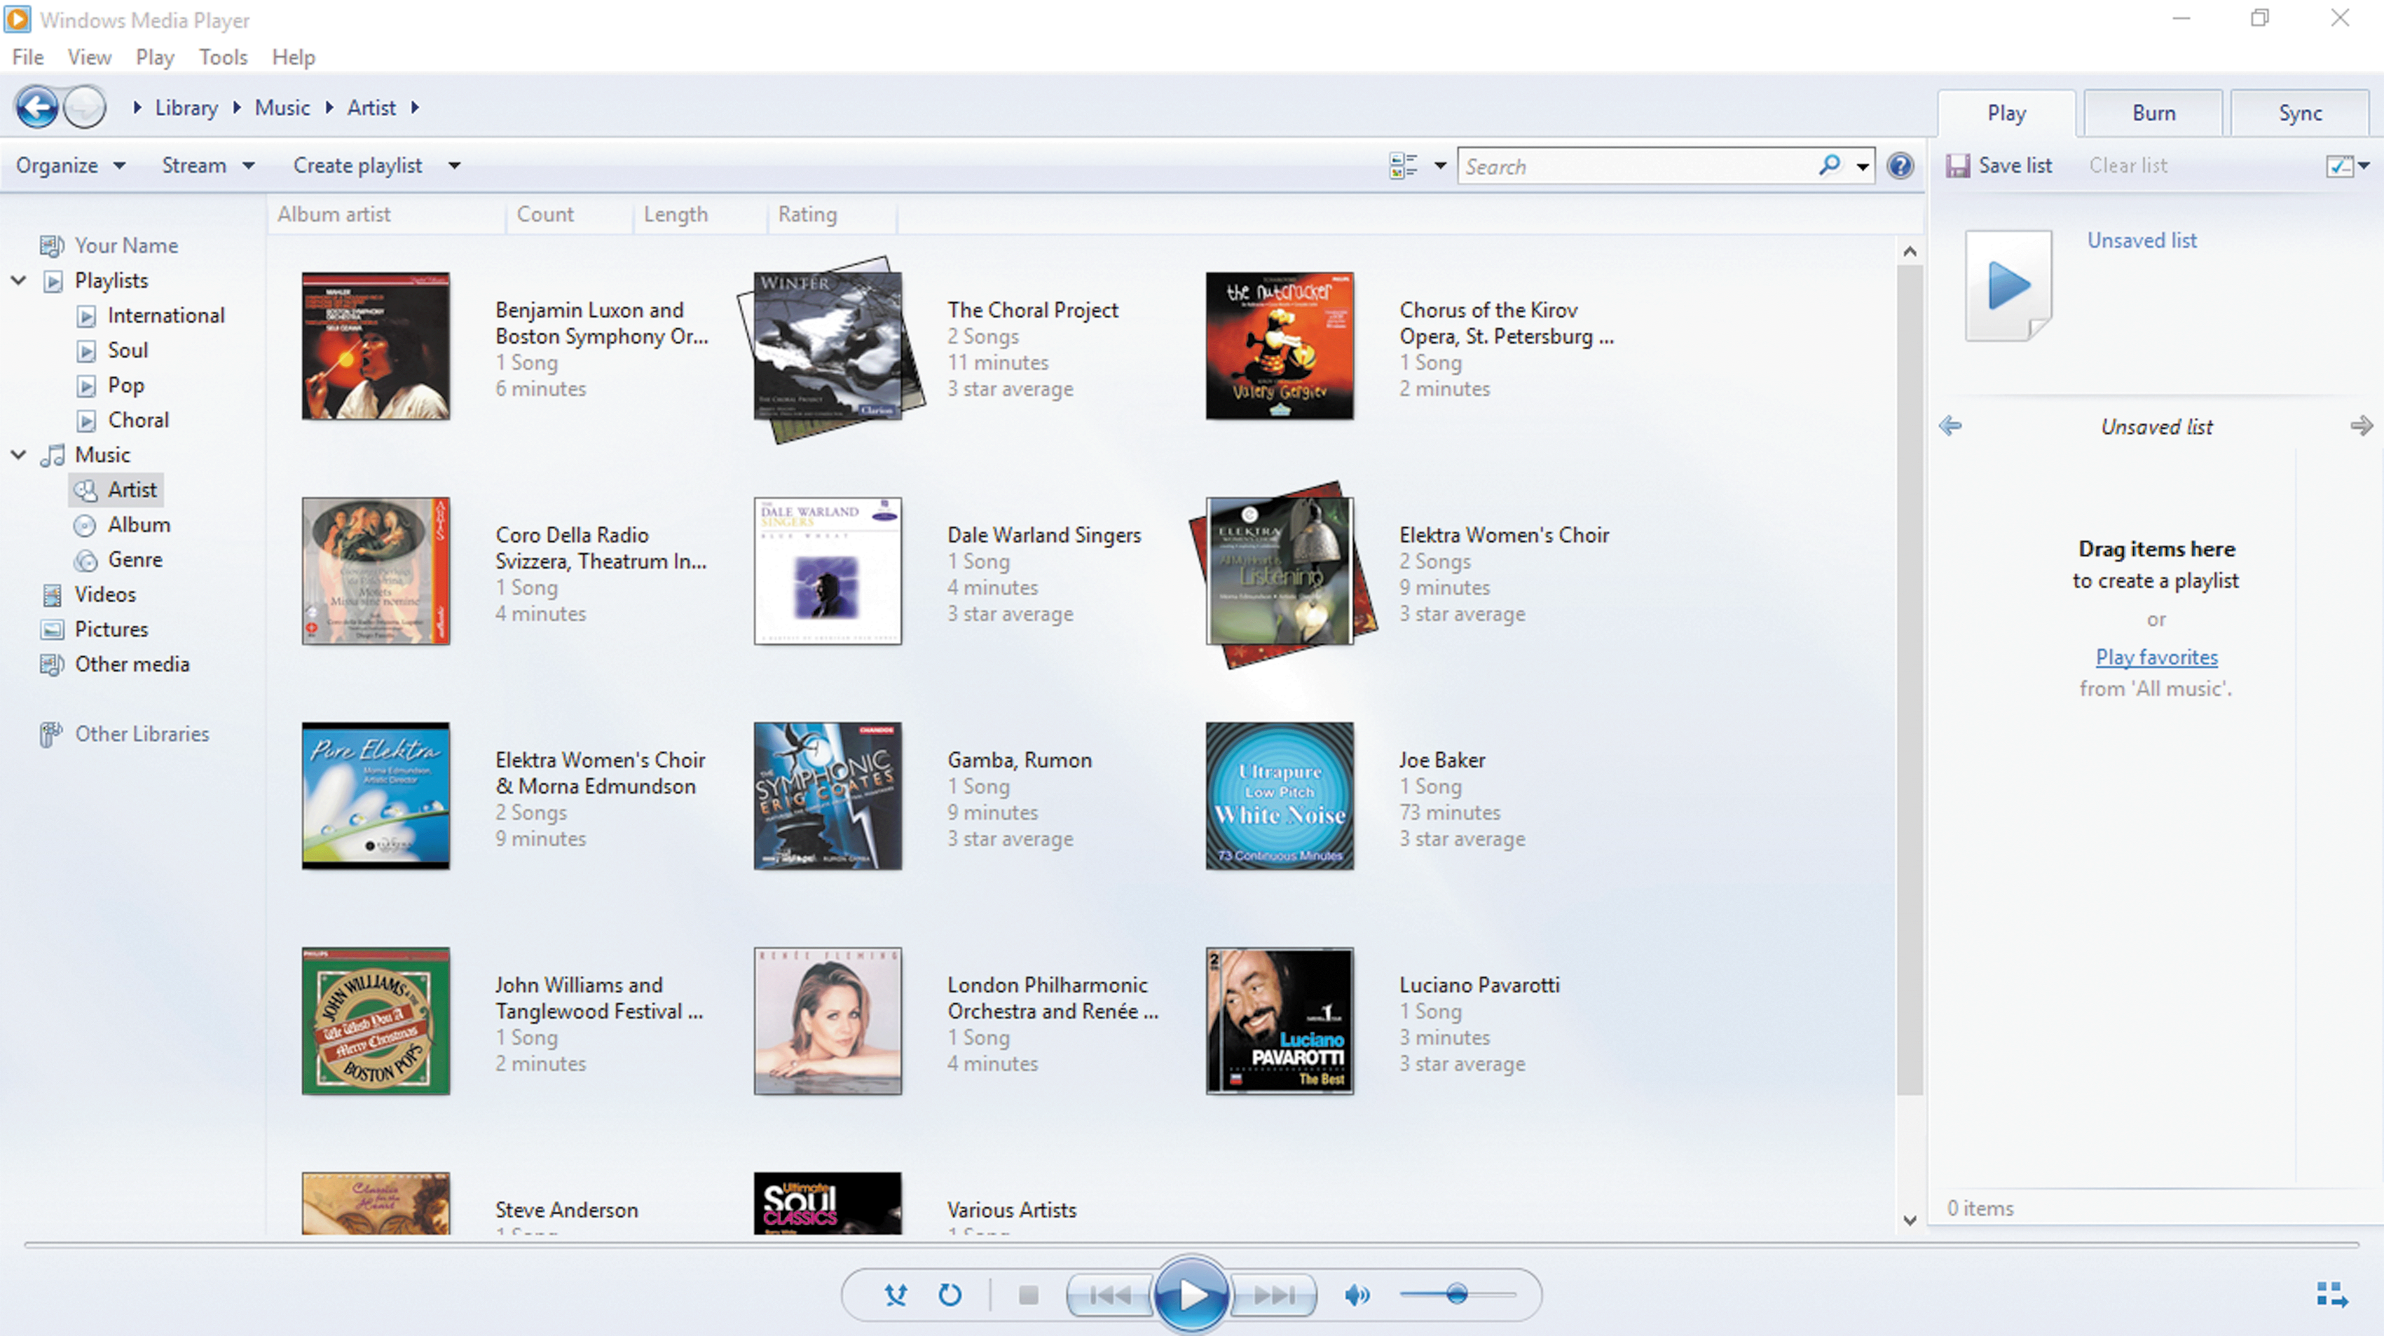
Use Windows Media Player (Slide 2 of 2)
Library window in Windows Media Player

Slide 13
Work with Media in File Explorer (Slide 1 of 2)
The Music and Video folders are designed to play and manage music and video files
Downloaded music and video files are saved in the Music and Video folders by default
The folders contain specialized tabs to play your media
Voice Recorder app allows you to record your own sound files
Can add sound effects to common Windows commands using the Sound dialog box.

Slide 14
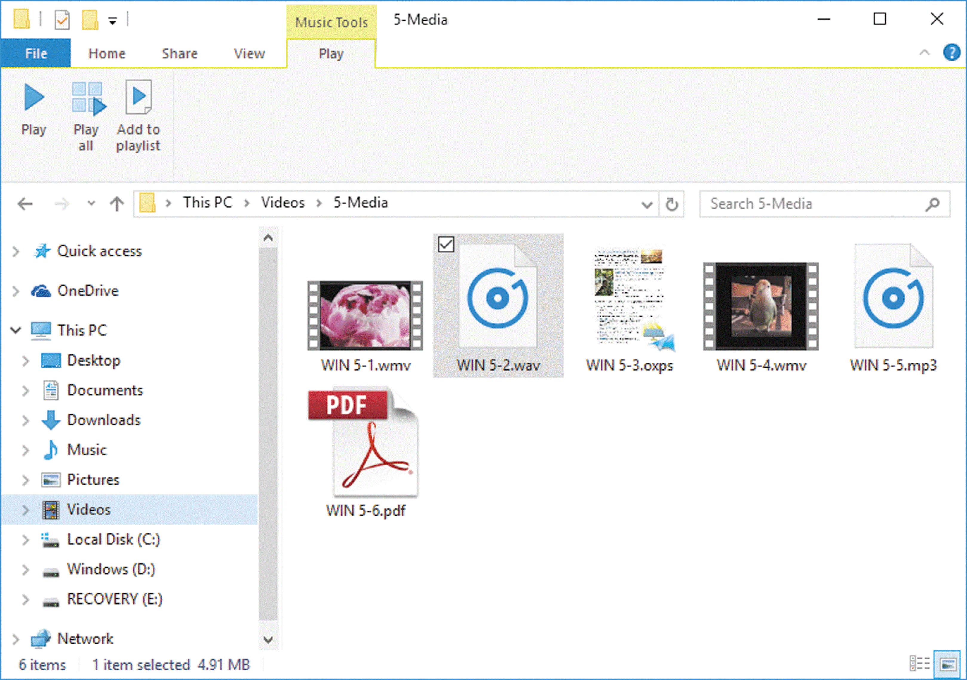
Work with Media in File Explorer (Slide 2 of 2)
Viewing media files in File Explorer

Slide 15
View and Read Documents
Reader app allows you to open and browse PDF and XPS files
XPS is Microsoft’s version of a PDF file
You can open XPS documents with the XPS Viewer

